Slide 1
Module 0: Introduction
NC State scRNA Workshop, 2024

Slide 2


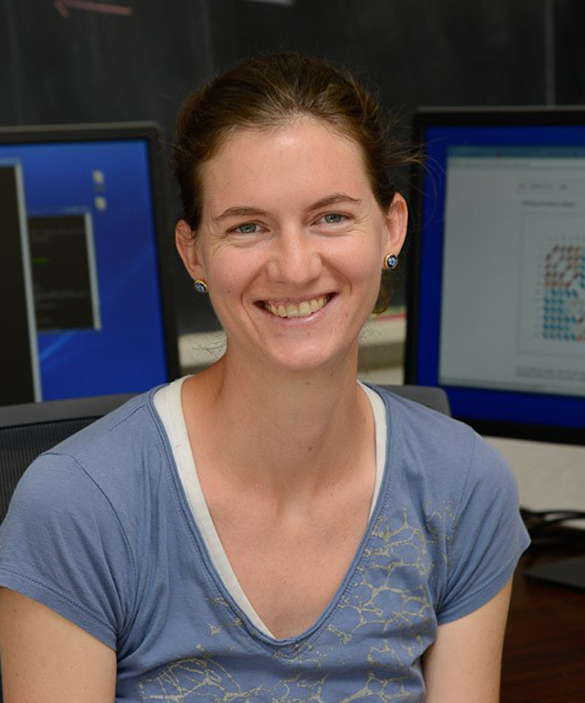

Meet your Instructors
Bruce Corliss, PhD
Research Bioinformatician at NC State
Support for Dr. Fred Wright (BRC),
Dr. Cathrine Hoyo (Biological Sciences), and the
Center for Human Health and the Environment
Allison Dickey, PhD
Research Associate at NC State
Bioinformatics Consulting & Service Core

Slide 3
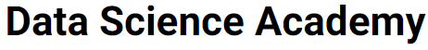
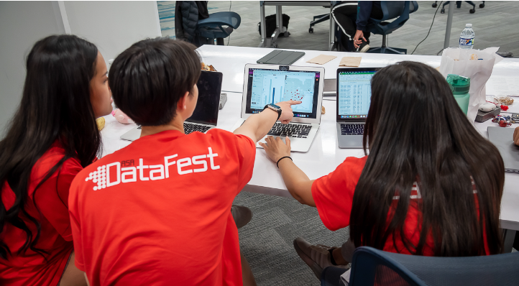

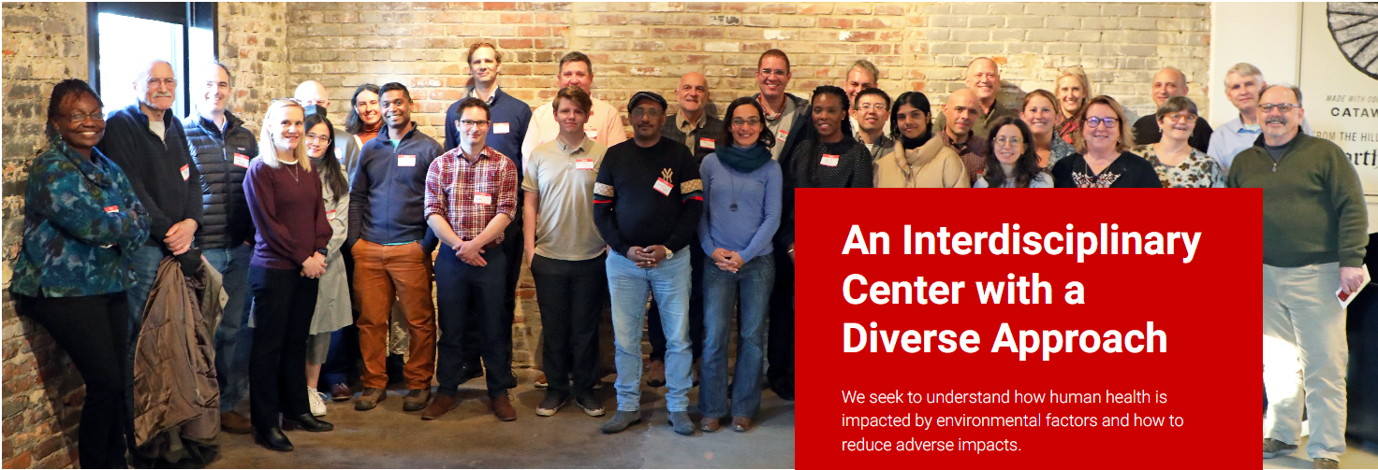
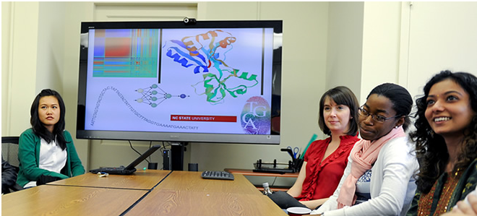
Workshop Sponsors
Bridging biological research and data science for the next generation of scientific discoveries.

Slide 4
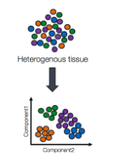
Learning Objectives
Overarching Purpose: to discuss the basics of processing and interpreting scRNA-Seq Data. Participants will learn new analysis techniques through technical summaries and gain an understanding of the workflow from this workshop.
Understand the basic process of how single cell RNA-seq is analyzed.
Familiarity with standard processing pipeline with Seurat.
Intuitive understanding of the need and concept for each part of the pipeline.
Perform basic DGE and cell type labelling.
Use Monocle to perform cell trajectory and cell fate analysis.
What does this workshop not cover?
How to experimentally confirm your single cell results following the standard of practice for your subfield.
How to generate high fidelity cell type labels (can take months/ years of effort).
A mathematical understanding of the processing pipeline.
How to tailor these standard concepts to your specific research needs.

Slide 5
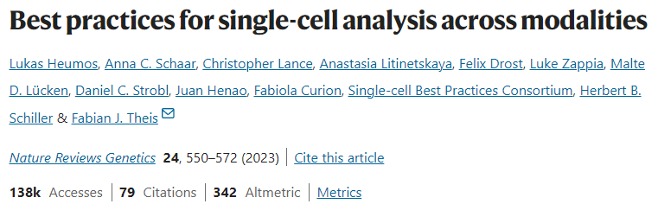
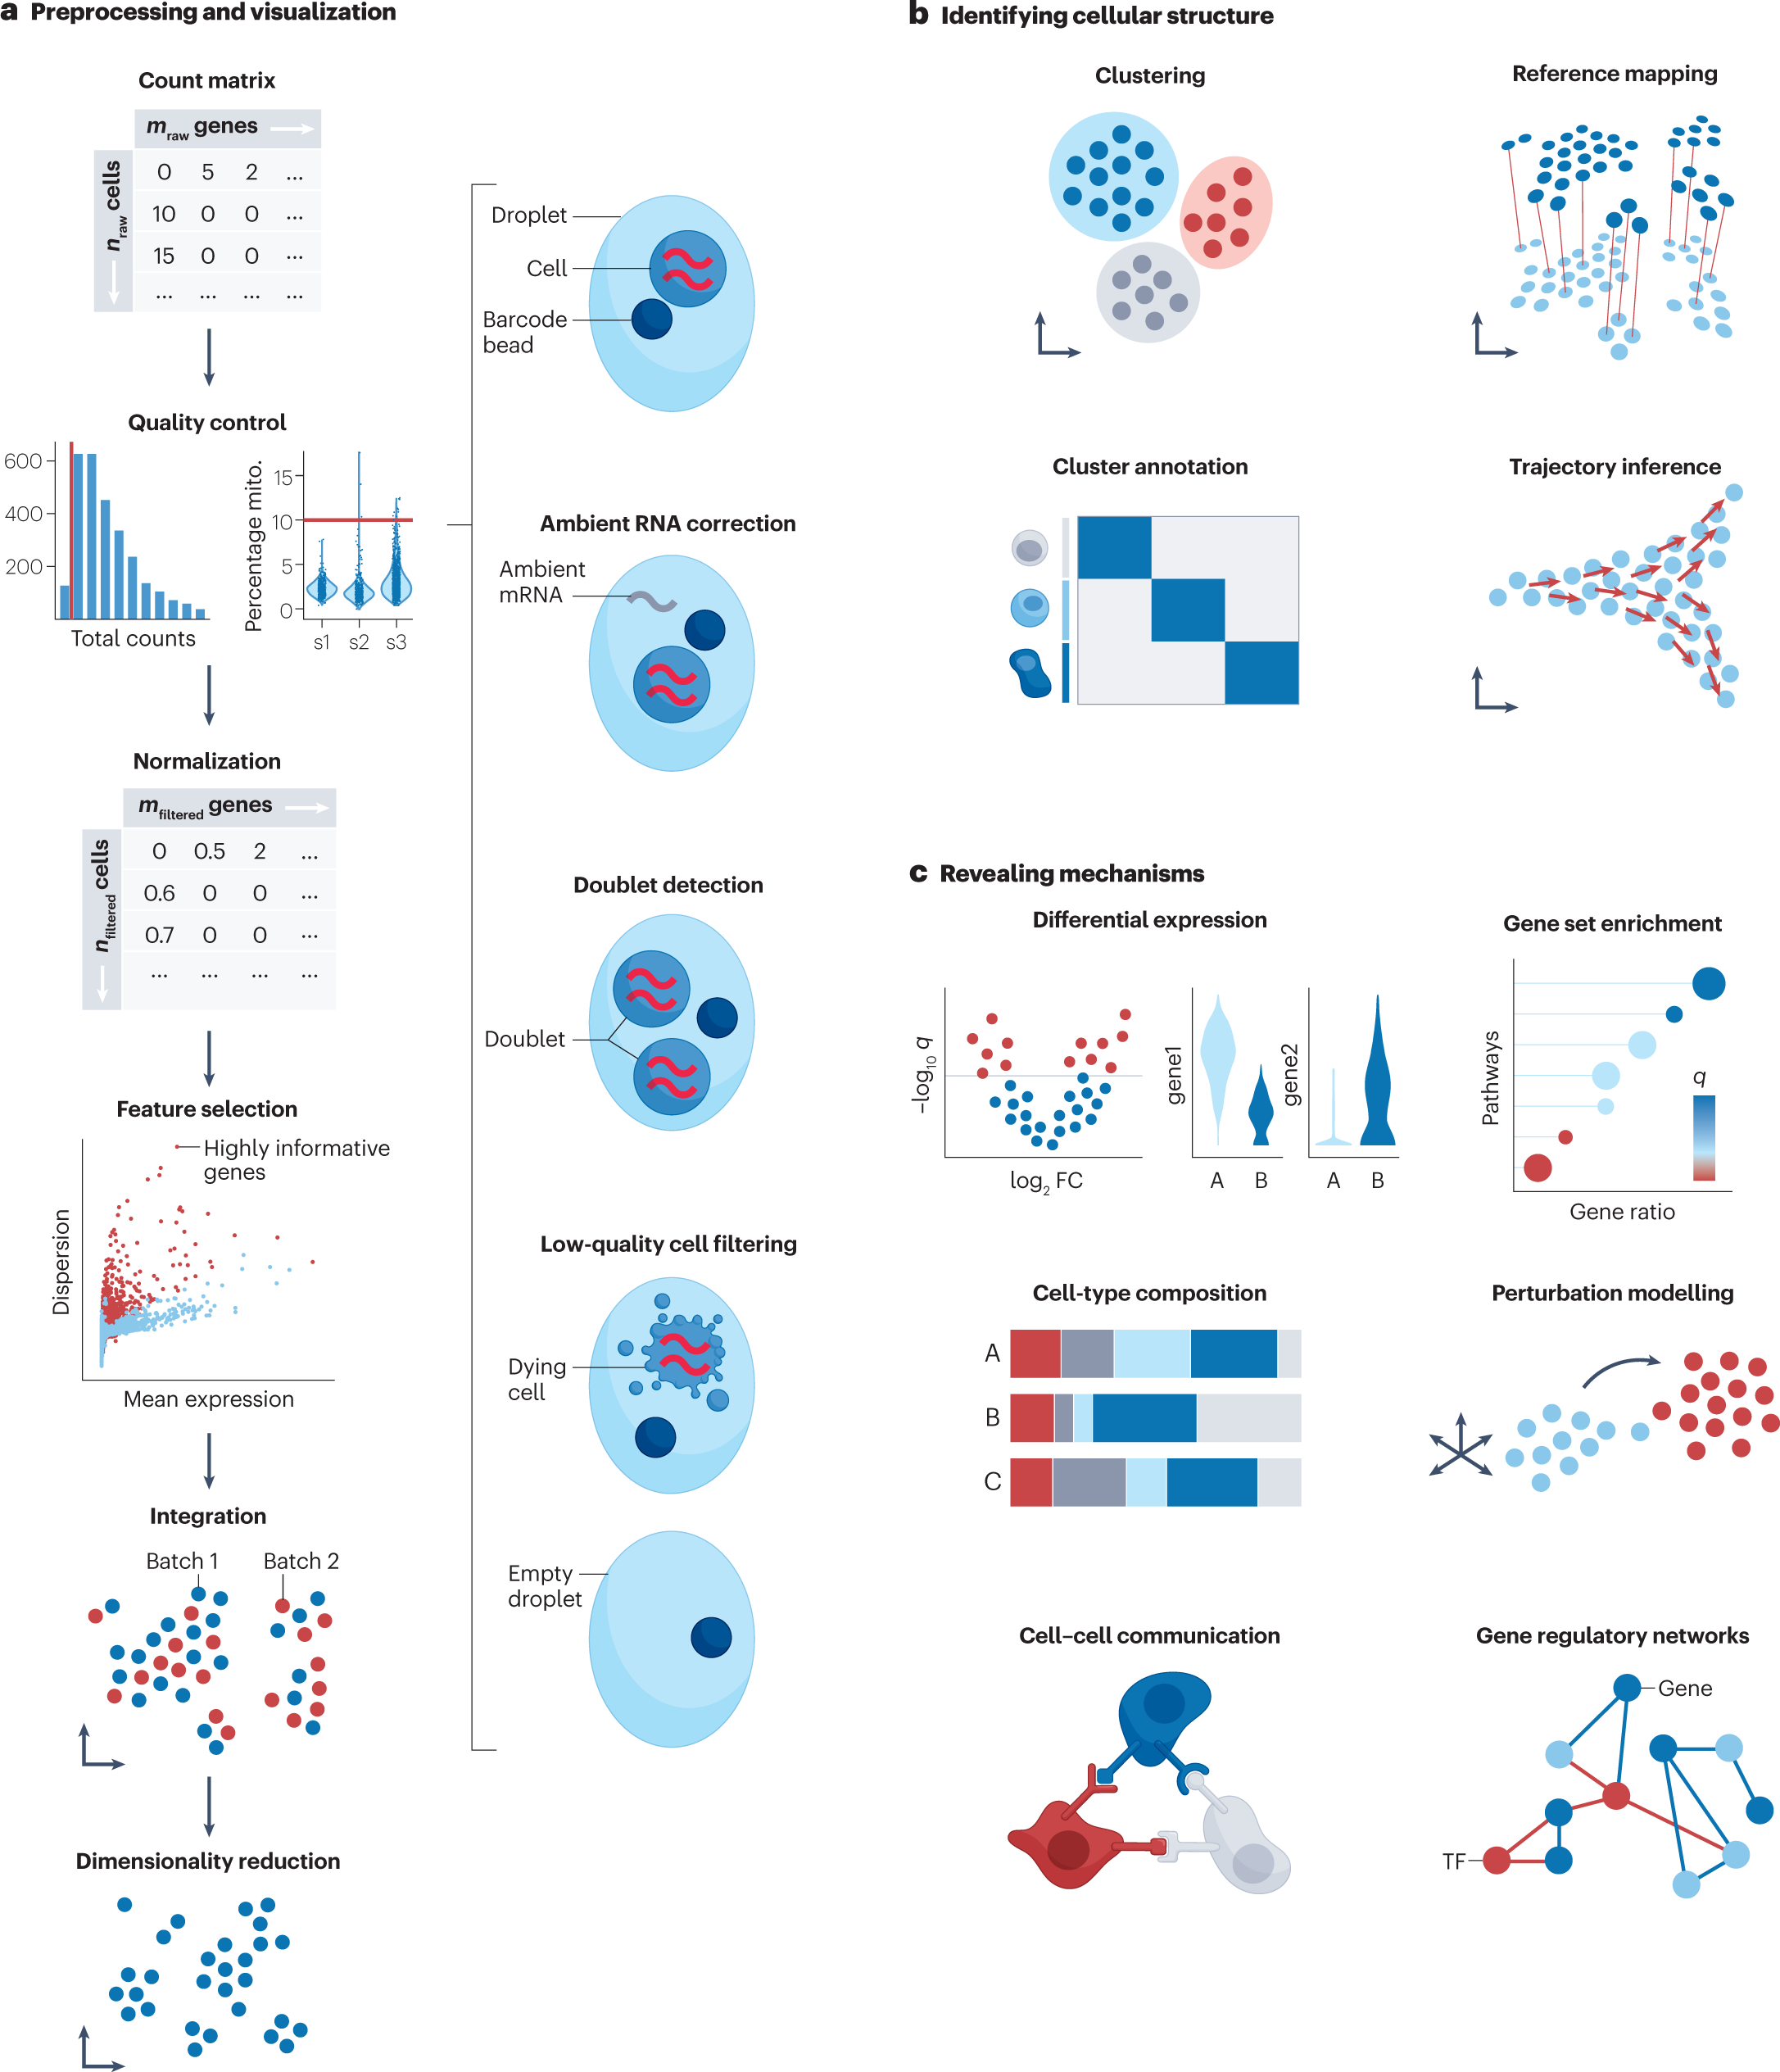
Post Workshop Assignment

Slide 6
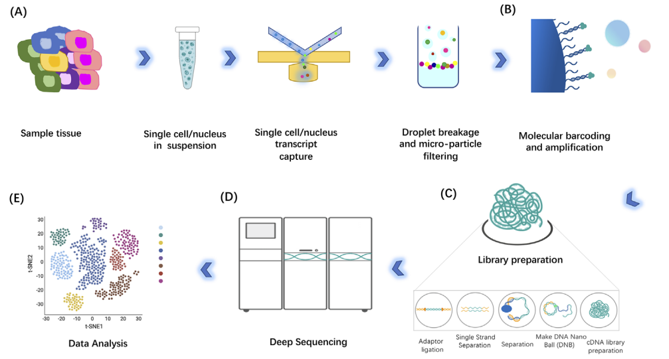
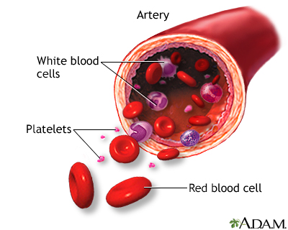
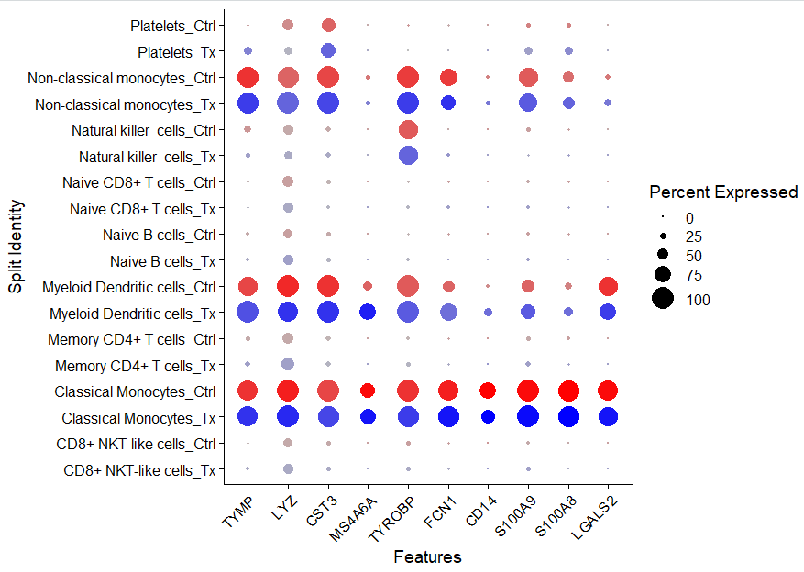

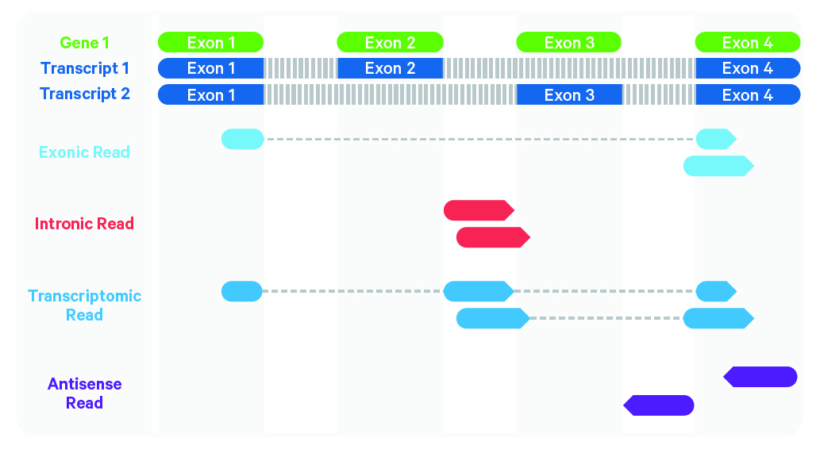
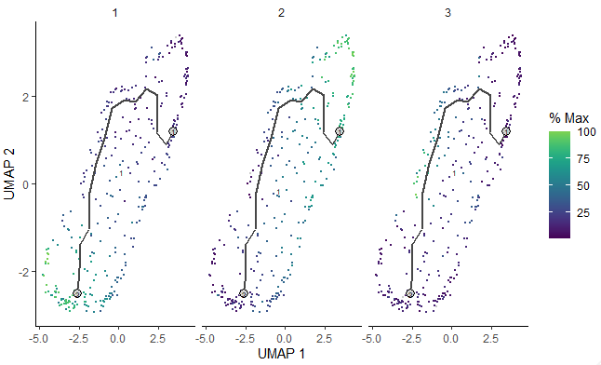

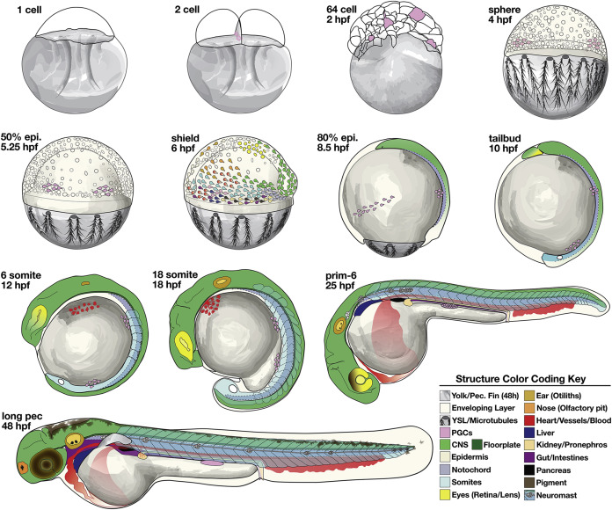
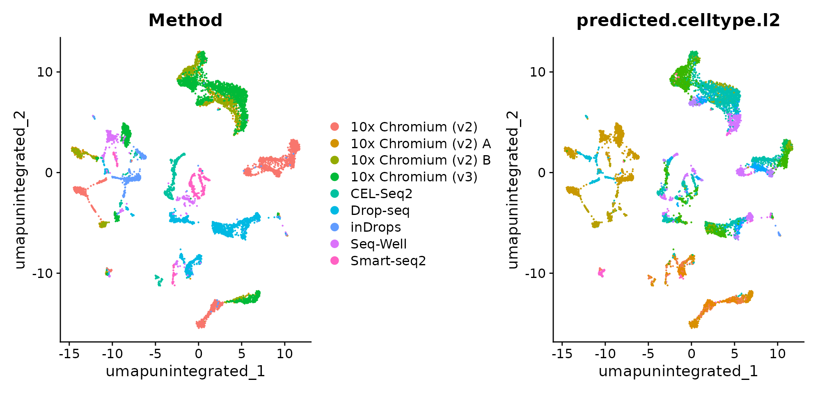
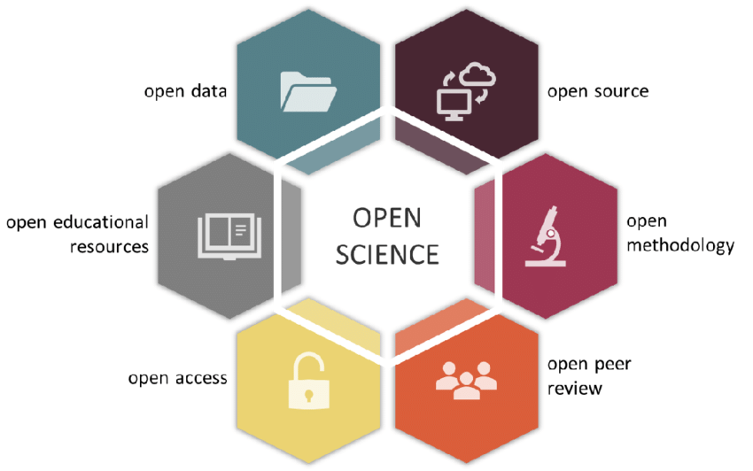
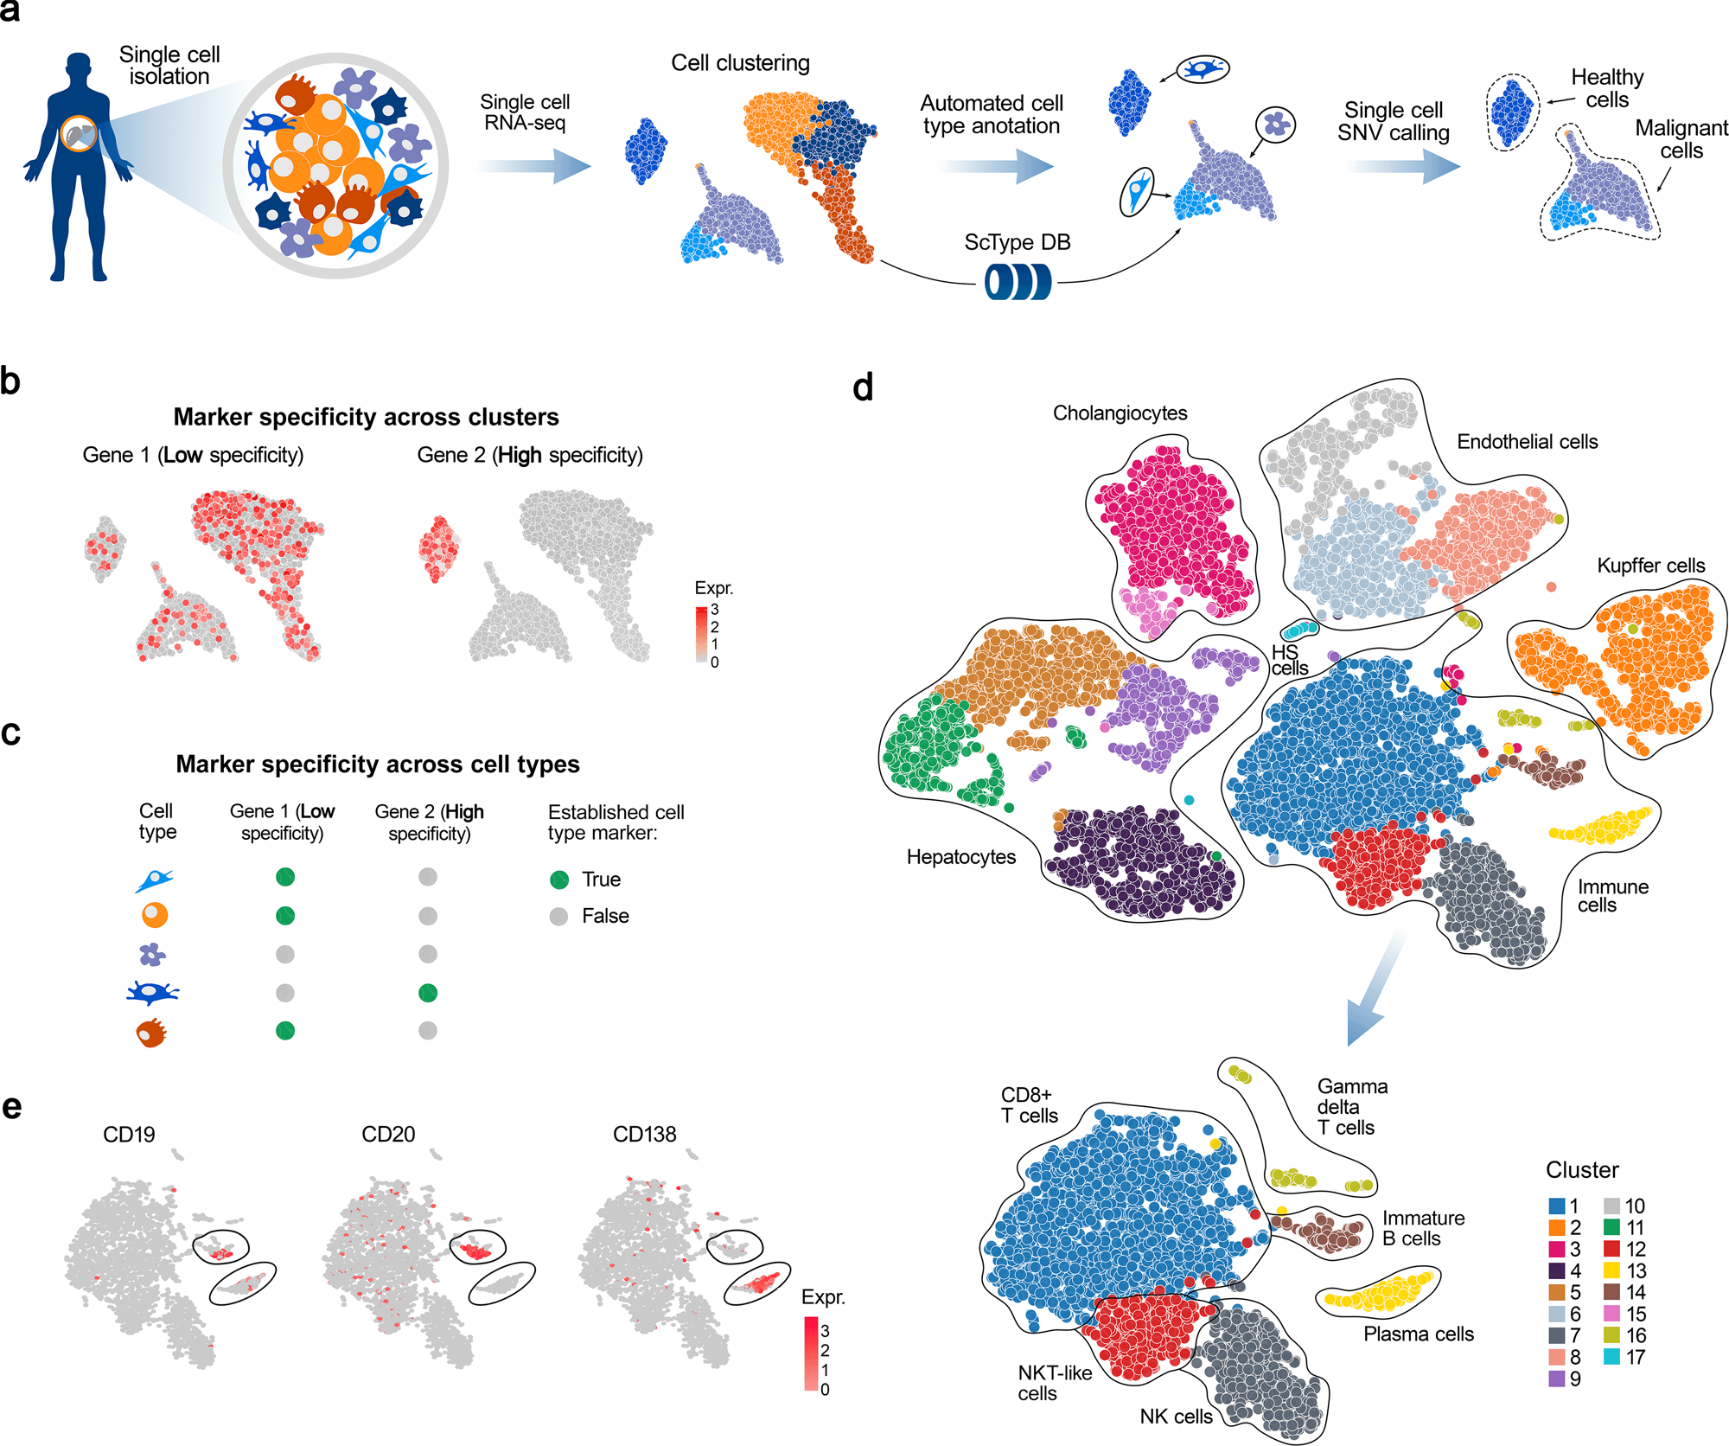
Overview of Course Modules
Intro scRNA-Seq
Cell Ranger Read Alignment
Seurat Processing Pipeline
Cell Type Identification
Teaching Dataset
5) Seurat Exploratory and DGE
6) Monocle Pseudotime
7) Best Practices and Summary
Blood Sample,
Healthy Donor
Interactive Dataset
https://www.mountsinai.org/health-library/tests/blood-smear
Narendra. Academic Press (2020) Pages 559-591.

Slide 7
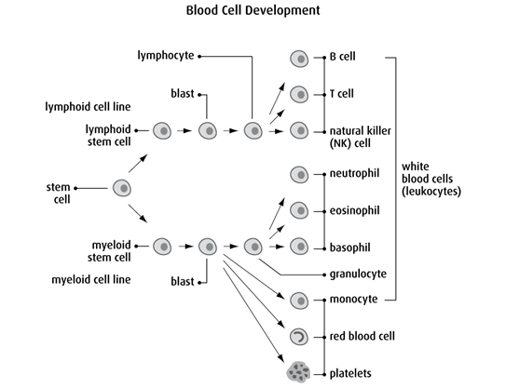
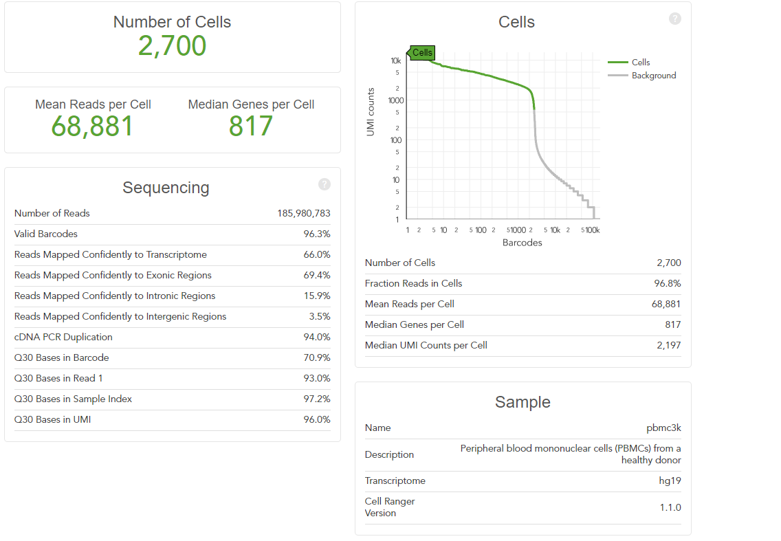
The Teaching Dataset
Peripheral blood mononuclear cells (PBMCs) from a healthy donor
Used for all powerpoints and the test_pipeline.R script.
Artificially altered for Dataset Integration, Differential Gene Expression, and Cell Trajectory/ Pseudotime Analysis to illustrate the null case.
https://cf.10xgenomics.com/samples/cell-exp/1.1.0/pbmc3k/pbmc3k_web_summary.html
https://cancer.ca/en/cancer-information/what-is-cancer/blood-and-bone-marrow

Slide 8
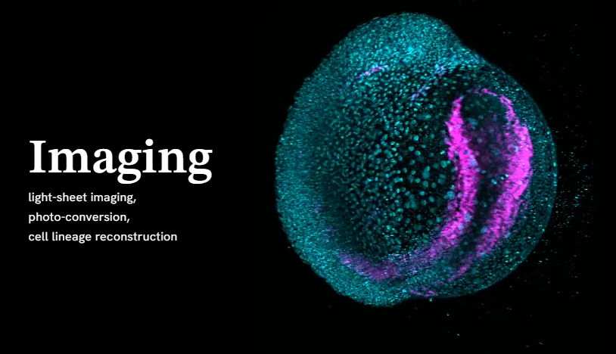
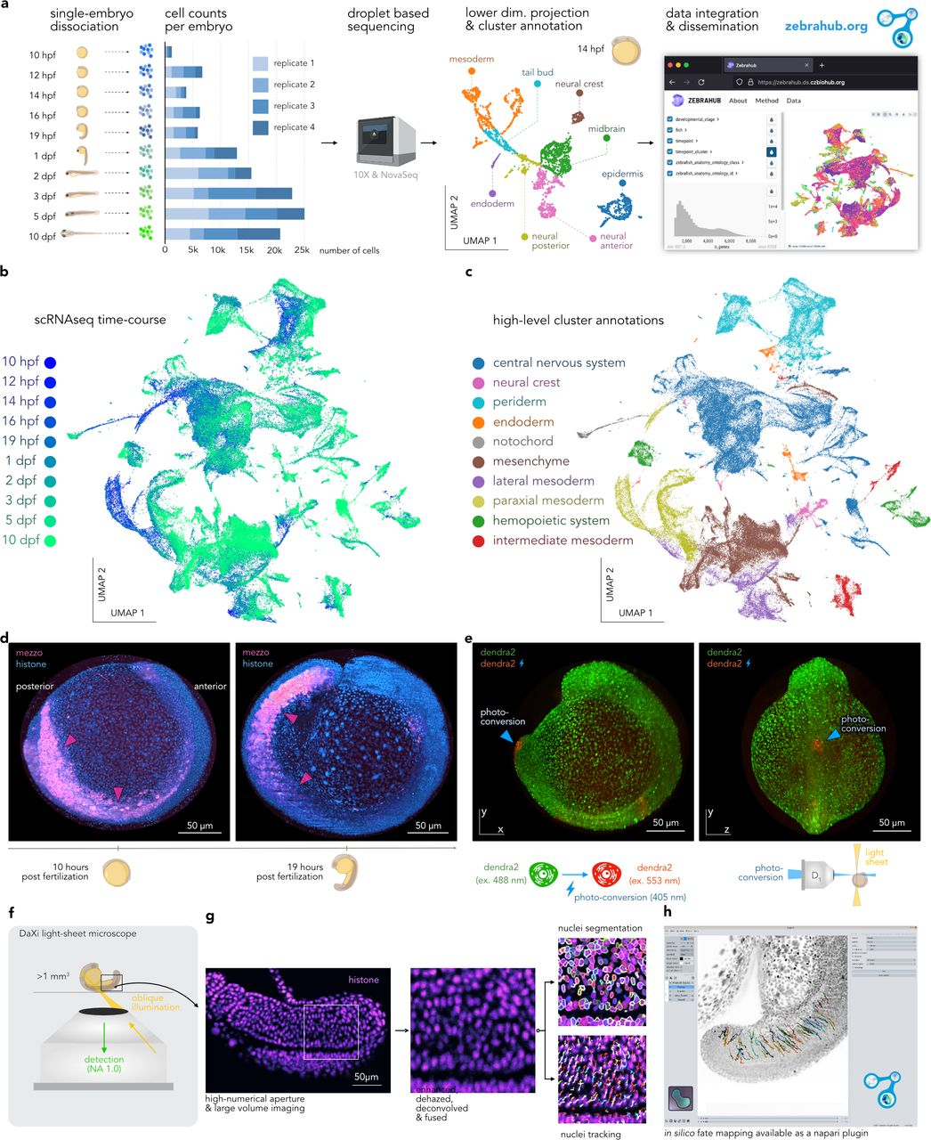
The Interactive Dataset
Zebrahub is a comprehensive atlas of zebrafish embryonic development.
Technologies: single-cell RNA sequencing and live light-sheet imaging.
Provides a complete cartography of cellular lineages in space, time, and molecular domains, an essential step toward understanding how organisms develop.
Zebrahub - Multimodal Zebrafish Developmental Atlas Reveals the State Transition Dynamics of Late Vertebrate Pluripotent Axial Progenitors. Lange et al. BioRxiv 2023.

Slide 9
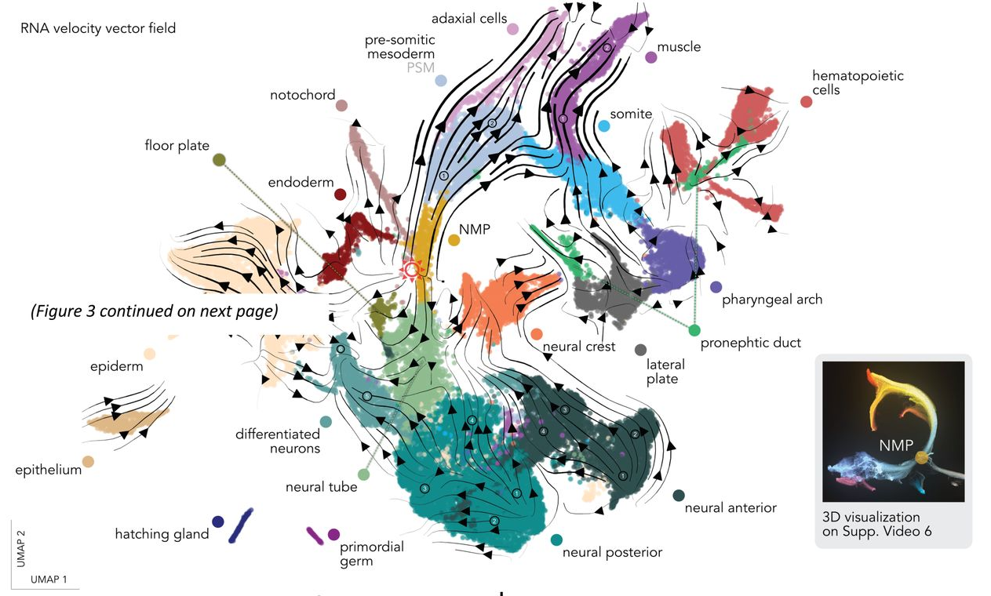
The Interactive Dataset
Cell type annotated and embryonic tissue annotated.
Zebrahub - Multimodal Zebrafish Developmental Atlas Reveals the State Transition Dynamics of Late Vertebrate Pluripotent Axial Progenitors. Lange et al. BioRxiv 2023.

Slide 10
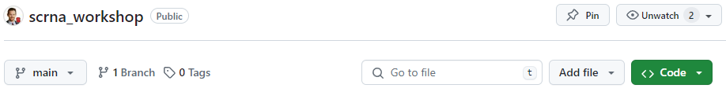
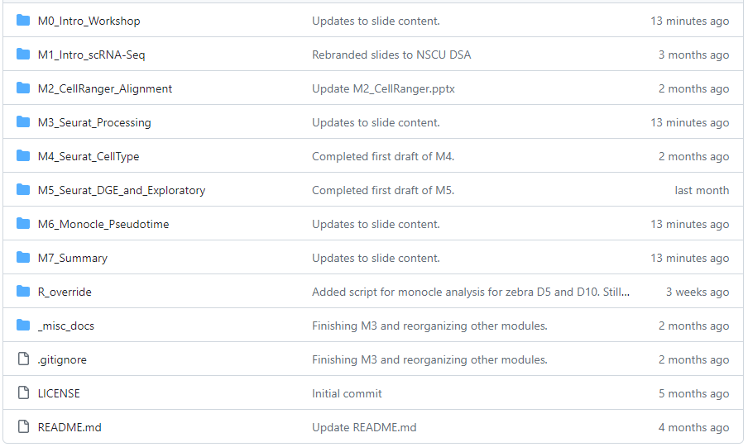

Materials for Workshop
Slides with example code/ output used to analyze data.
All code for analyzing PBMC dataset is found in
/M0_Intro_Workshop/test_packages.R
All code for analyzing zerbahub dataset are found in
/M3_Seurat_Processing/Module3_part1.Rmd
/M3_Seurat_Processing/Module3_part2.Rmd
/M4_Seurat_CellType/Module4_5.Rmd
/M6_Monocle_Pseudotime/zebra_pseudo_time.R
https://github.com/
bacorli2/scrna_workshop

Slide 11
General Approach with Slides: Busy but Informative
Code snippets
Outputs (visualizations)
Text with description
Flowchart of pipeline

Slide 12
Bridging biological research and data science for the next generation of scientific discoveries.

